Slide 1
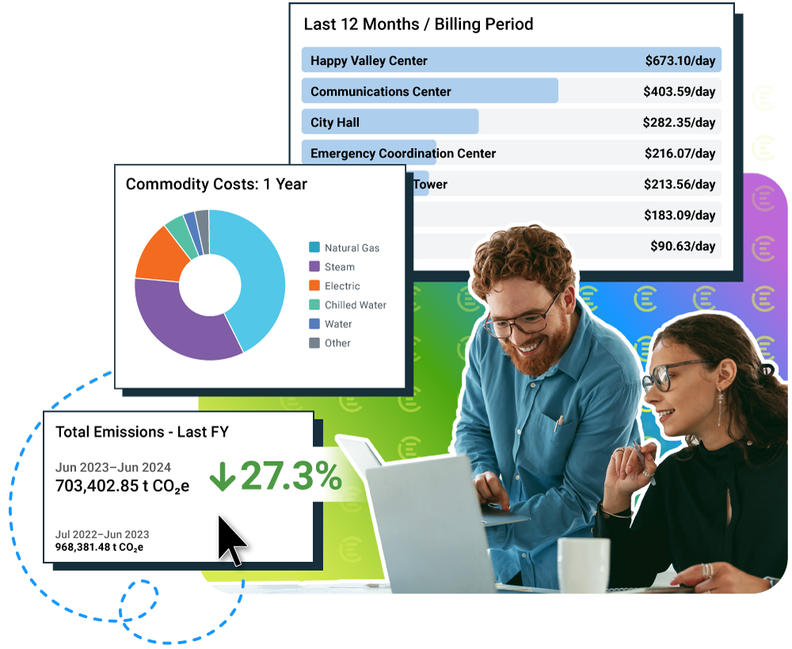


Pitch to purpose:
Build a winning business case for energy software
Sarah Uranowski
Director of Product Marketing
EnergyCAP

Slide 2
Today’s
Identify the need for reliable data
Outline key benefits and ROI
Build the financial case
Overcome stakeholder objections
Craft a persuasive proposal
agenda

Slide 3

What steps are involved at your organization for purchasing software?
RFP or formal justification process
Buying committee review
IT/Cyber security sign off
Board or council approval
Formal procurement involvement
Notes:
The first thing that’s critical to understand: what steps are involved at your organization for purchasing software.
The 2nd key question: the threshold for buying, do you have an amount of money you can purchase up to without going through that RFP?
The final question is time of budget – what is your budget cycle, your fiscal year, etc.?

Slide 4




Speak their language
Know your decisionmakers
Facilities/operations
Care about comfort, safety, and troubleshooting
Schoolboard
Care about transparency, goal achievement, student well-being
CFO/ Finance teams
Care about forecasting, avoided costs, grant eligibility
Superintendents
Care about budgets, community perception
Your language
Less work, not more
Justify upgrades
Time savings, not just cost
Your language
Justify CApEx requests
Meet goals
Demonstrate stewardship
Your language
Controllable costs
Automate reporting
Identify savings
Your language
Operational savings without sacrifice
Protect instructional time and space
© EnergyCAP, LLC
Notes:
You need to become a salesperson
Try “selling without selling”: if you're telling your school district why energy management software matters, you're not pitching features, you’re translating outcomes into terms your stakeholders care about: budgets, student outcomes, board optics, and compliance.

Slide 5
The Texas
Energy landscape
v
v
v
Utility expenses rising
Peak demand charge volatility
Load management
Rising energy prices
Operational blind spots
No single source of truth
Reactive, not proactive
Manual processes delay response
Traditional energy management
Spreadsheets are error prone, siloed, and difficult to maintain
Increasing mandates for emissions tracking
Commands to “do more with less”

Slide 6

The energy management challenge
Manual processes and fragmented data
  Decentralized utility billing systems (spreadsheets and manual entry)
  Time-consuming data collection and error-prone reporting
  Operational and financial impact
  Wasted employee hours and missed cost-saving opportunities
  Difficulty tracking and reporting on sustainability goals

Slide 7

The need for reliable data
Why good data matters:
  Accurate, centralized utility data is the foundation for effective energy management
  Enables proactive insights, compliance, and strategic decision-making
Impact on business outcomes:
  Improved operational efficiency
  Enhanced sustainability reporting and stakeholder accountability

Slide 8
Benefits
Of energy management software
YoY Cost savings
Time savings
Enhanced reporting and decision-making
Compliance and reporting
EnergyCAP average: 7.5%
Berkeley National Labs average: 3%
Average of 37 hours per month saved in employee time
Automated data collection, real-time analytics, and integrated dashboards
Emissions tracking for reporting compliance
  BPS
  Benchmarking
  CA emissions reporting
This is an option or the slide with both diagrams

Slide 9
EMS savings maturity model
“In my decades as an energy manager, 25% savings was always within reach as long as you had three things: a committed team, strategic efficiency projects, and EnergyCAP to uncover and track the opportunities.”
Tom Diliberti // Sr. Manager, Energy & Sustainability
Comply and report
Simplified ESG & GHG reporting ​
Time savings ​
Improved compliance readiness.
Streamline financials
Eliminate late fees, streamline accounting and AP processes, and hand off payments.
Monitor usage
Energy usage monitoring ​
Efficiency upgrades (CAPex)​
Operational savings (schedules, set points, proactive mgmt)
Shut it off, set it back, and tune it up!
Automate data
Automation of bill entry ​
Reduced manual effort ​
Additional billing errors identified
Utility bill management
Data consolidation ​
Time savings ​
Low-hanging fruit from bill auditing & benchmarking
1–3% savings
+2–5% savings
+5–10% savings
+3–4% savings
+1–3% savings
1%
Cumulative savings
25%

Slide 10

10 reasons to buy EMS
Savings: Reduce utility bills and free up funds for energy projects
Simplified processes: Automated billing, error detection, and reporting
Single source of truth: Centralize all energy data
Granular insights: Data-driven decisions at building and portfolio levels
Maximized ROI: Clear financial benefits and quick payback
Enhanced reporting: Audit-ready and customizable dashboards
Data accuracy: Eliminate manual errors and silos
Proactive management: Real-time alerts and predictive maintenance
Simplified carbon accounting: Automated GHG tracking (Scope 1, 2, and 3)
Future-proofing: Scalable, secure, and compliant with evolving standards
1
2
3
4
5
6
7
8
9
10
Notes:
Use this as a checklist when you’re looking at energy management software. Does the proposed solution meet your requirements and give you what you need?

Slide 11
Building
The financial case
ROI analysis
Cost-benefit comparison
Budget justification
  Typical payback within 2—3 years
  Quantifiable savings from energy waste reduction and error detection
  Compare current inefficiencies (manual processes, missed savings) against the cost of implementation
  Leverage ROI calculators and historical customer data (e.g., 10%+ savings, 2.6-year average ROI)
  Align the software investment with operational budgets and capital improvement plans
  Consider available grants, rebates, and incentives
This is an option or the slide with both diagrams

Slide 12
Overcoming
Common objections
Common concerns | “It’s too expensive” “We’re fine with spreadsheets” “We don’t have the resources”
Counter strategies | Demonstrate fast ROI and long-term savings Outline the opportunity cost of “not acting” Highlight time and cost savings with measurable metrics Present real-world success stories
Consensus building tips | Build a coalition of champions across facilities, finance, IT, and sustainability team Present a clear, unified vision for operational excellence
This is an option or the slide with both diagrams

Slide 13

Craft a winning proposal
Executive summary
Define objectives and key benefits
Current challenges
Detail manual inefficiencies and data fragmentation
Proposed solution
Introduce energy management software (EnergyCAP) and its features
Cost benefit analysis
Outline savings, ROI, and payback period
Implementation plan
Phases, training, and support
Stakeholder impact
Benefits for facilities, sustainability, finance, and IT
Risks and mitigation
Address potential concerns and strategies
Tools and templates
Use EnergyCAP’s proposal templates for a structured, persuasive pitch
Scan QR to get a proposal PowerPoint template

Slide 14
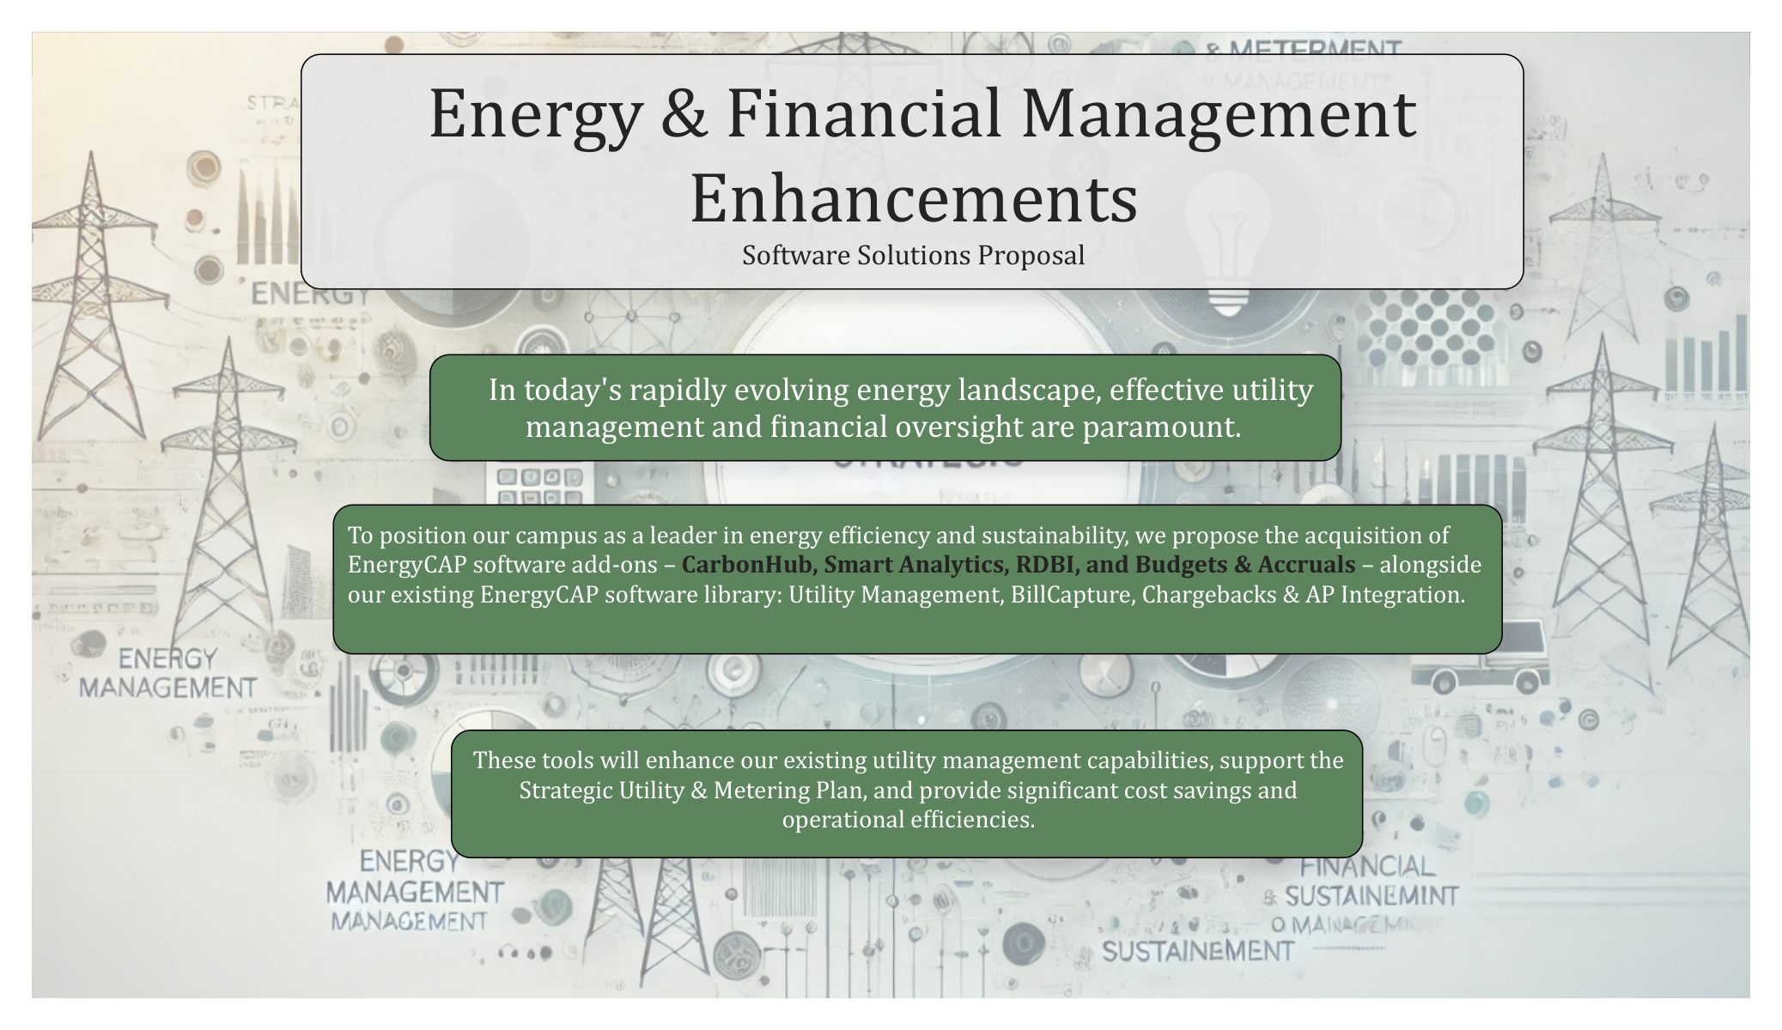
Executive summary
Summarize the ask
  Start with “why”
  Emphasize strategic alignment
  Stay outcome-focused

Slide 15
Current challenges
Summarize the ask
  Know your audience
  Quantify pain
  Emphasize expense, urgency, and noncompliance as “the cost of doing nothing”
Why? Cost savings, efficiency, hit plan
Notes:
Warning: If your challenges don’t sound expensive, urgent, or operationally painful—you won’t get funding.

Slide 16
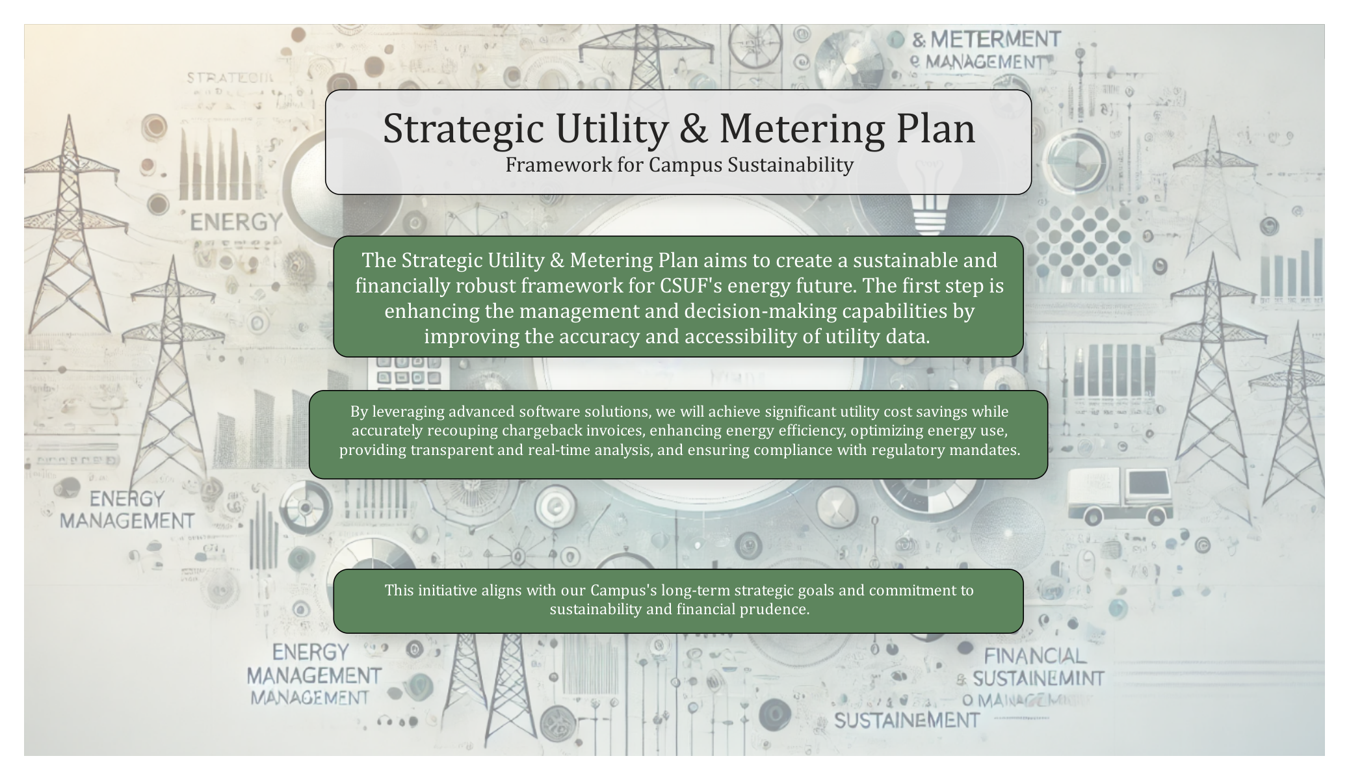
Proposed solution
  Don’t lead with features
  Reference case studies and peers
  Frame the software as an enabler

Slide 17
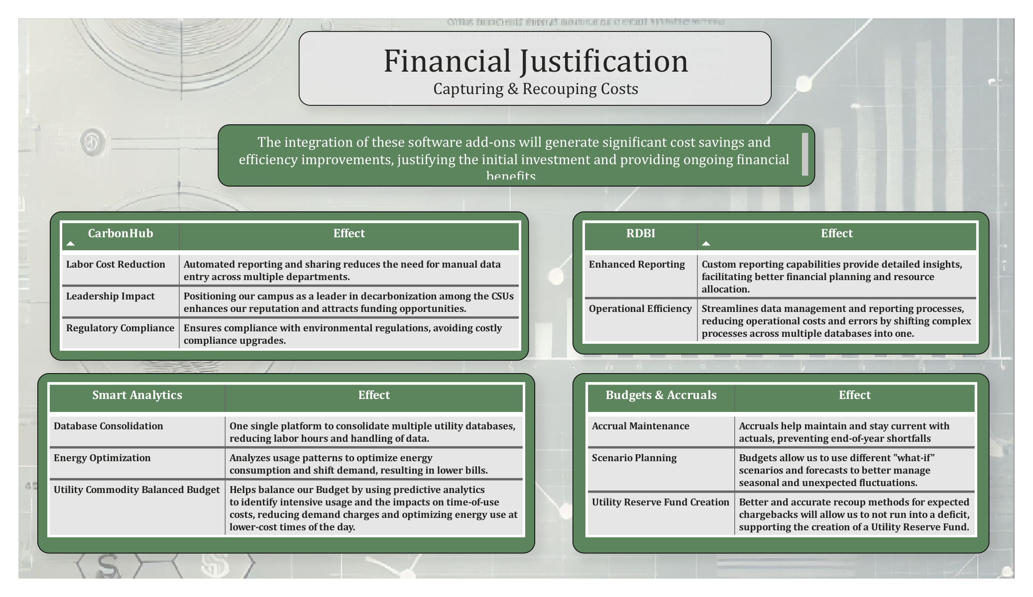
Cost-benefit analysis
  Show ROI
  Use conservative estimates
  Include intangibles

Slide 18
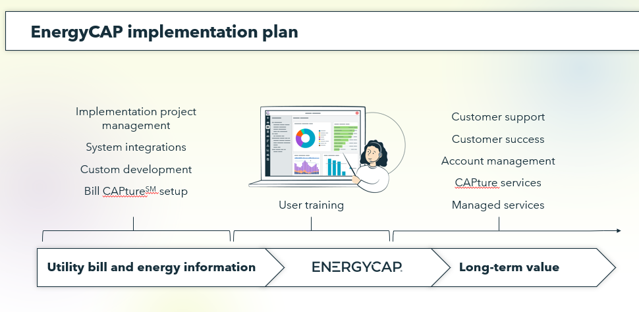
Implementation plan
  Show the phases
  Address support
  Emphasize quick wins

Slide 19
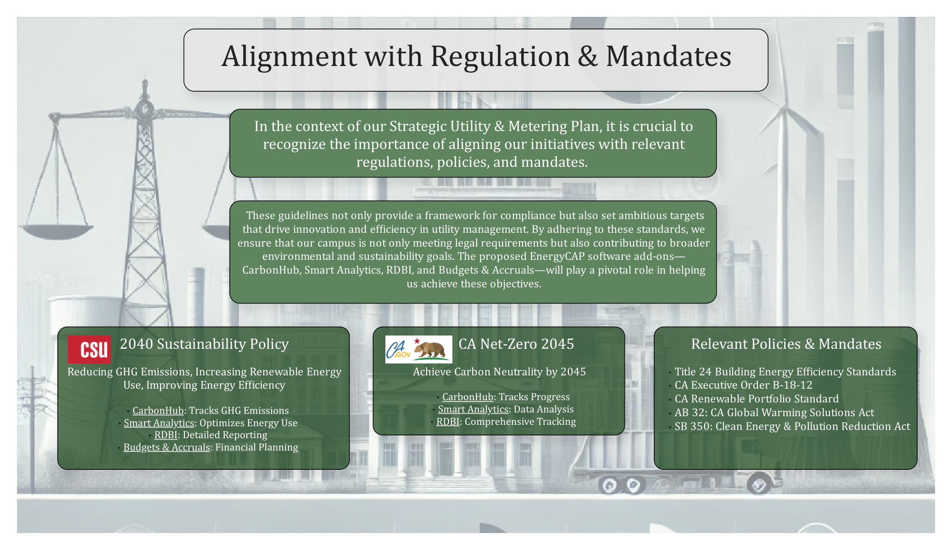
Stakeholder impact
  Align to strategic goals
  Emphasize cross-department benefits and outcomes
  Tie to KPIs and mandates

Slide 20
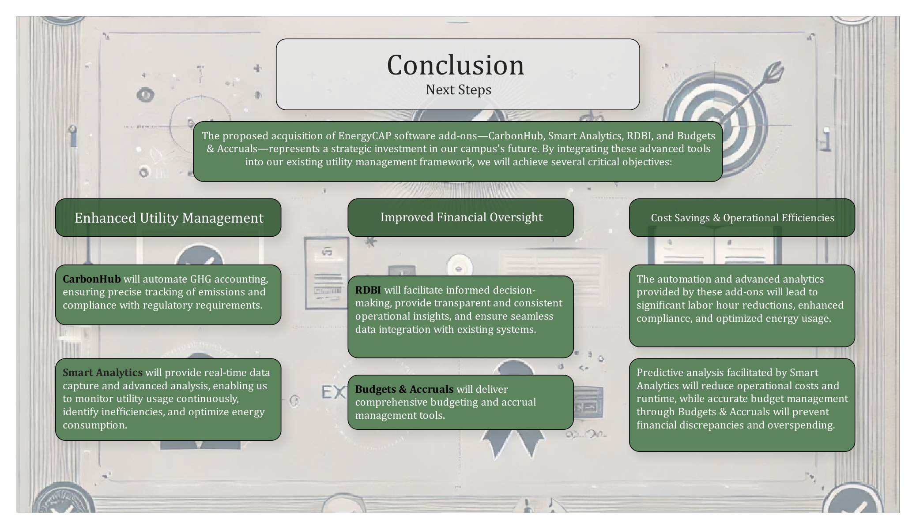
Risks and mitigation
  Acknowledge and anticipate
  Quantify the risk
  Rely on your “buyer committee”

Slide 21
Q&A
Check out upcoming events and webinars at
www.EnergyCAP.com/events

Slide 22


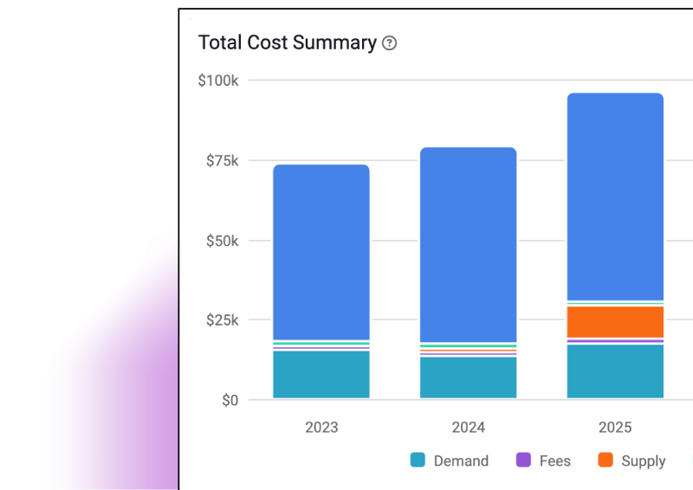


The EnergyCAP solution
Built your way.
Start with Utility Management
Our core platform centralizes all your utility and energy data.
Powerful add-ons:
Smart Analytics
Interval data to analyze usage trends, dig into anomalies, and find savings—powered by AI.
Advanced Accounting
Our powerful trio of accounting features: accounting export, utility budgets, and bill accruals.
Carbon Hub
Powerful utility-based carbon tracking and streamlined GHG reporting tools.
Chargebacks
Quickly allocate and recoup utility costs from tenants, across departments, by project, and more.
Bill CAPture
Let us collect, capture, and process
your utility bills with specialized bill processing services.
BI reporting
Connect your energy data using the power and flexibility of your favorite business intelligence applications: Power BI®, Tableau®, Excel, and others.
This is an option or the slide with both diagrams

